Slide 1
Software Engineering
Topic 2:
Software: Its Nature and Qualities
Your Name: _____________________
Computer Science & Engineering Department
The Chinese University of Hong Kong

Slide 2
The Nature of Software
Software is malleable
  modify s/w code is easy
  changes in s/w should be disciplined as __design__ changes, not merely __code___ changes
Software is human intensive
  it needs engineering, not manufacturing (a trivial process of duplication)
  software engineering process in every phase is human intensive
Software Quality is hard to define
  hard to separate software product from software process
  lack of quantitative measurement
Notes:
In some ways software products are similar to other engineering products, and in some ways they are very different. The characteristic that perhaps sets software apart from other engineering products the most is that software is malleable. We can modify the product itself-as opposed to its design-rather easily. This makes software quite different from other products, such as cars or ovens.
Another characteristic of software is that its creation is human intensive: It requires mostly engineering rather than manufacturing. In most other engineering disciplines, the manufacturing process determines the final cost of the product. Also, the process has to be managed closely to ensure that defects (i.e., bugs) are not introduced into the product. The same considerations apply to computer hardware products. For software, on the other hand, “manufacturing” is a trivial process of duplication. The software production process deals with design and implementation, rather than manufacturing. This process has to meet certain criteria to ensure the production of high-quality software.
Any product is expected to fulfill some need and meet some acceptance standards that dictate the qualities it must have. A bridge performs the function of making it easier to travel from one point to another; one of the qualities it is expected to have is that it will not collapse when the first strong wind blows or when a convoy of trucks travels across it. In traditional engineering disciplines, the engineer has tools for describing the qualities of the product distinctly from the design of the product. In software engineering, the distinction is not so clear: The qualities of the software product are often intermixed in specifications with the qualities of the software design.

Slide 3
Classification of Software Qualities
External Versus Internal Qualities
  external qualities are visible to the users
  internal qualities are of developers’ concern
  they are related to each other
  reliability – verifiability
  (_external_) (_internal_)
Notes:
The quality of software is assessed by a number of variables. These variables can be divided into external and internal quality criteria. External quality is what a user experiences when running the software in its operational mode. Internal quality refers to aspects that are code-dependent, and that are not visible to the end-user. External quality is critical to the user, while internal quality is meaningful to the developer only.
Some quality criteria are objective, and can be measured accordingly. Some quality criteria are subjective, and are therefore captured with more arbitrary measurements.

Slide 4
Classification of Software Qualities
Product and Process Qualities
  a process produces a product (of products)
  s/w product is not merely the final code and user manual (end-product); it includes deliverables in each intermediate phase (deliverables: requirements, design, code revisions, test data)
  they are also called work products or artifacts
  a s/w production process may produce several products (or versions) for different customers (needs Configuration Management - CM)
different ______hardware_________
different ______O.S. releases________
different ____s/w tool releases________
different _____capabilities_________
different ___customer-specific features_
CM specifies
differences in
Notes:
A software process can produce one or more software products.
The word product usually refers to what is delivered to the customer. Even though this is an acceptable definition from the customer's perspective, it is not adequate for the developer who produces a number of, intermediate "products" in the course of the software process. The customer-visible product consists perhaps of the executable code and the user manual, but the developers produce a number of other artifacts such as the requirements and design documents, test data, etc. We refer to these intermediate products as work products or artifacts to distinguish them from the end product delivered to the customer. Work products are often subject to the same quality requirements as the end product. Given the existence of many work products, it is possible to deliver different subsets of them to different customers.
Process quality:
− Software processes implement best practices of software engineering in an organizational context. Process quality expresses the degree to which defined processes were followed and completed.
Product quality:
− Software products are the output of software processes. Product quality is determined by the degree to which the developed software meets the defined requirements

Slide 5
Representative Qualities
Dependability
  correctness
    a program is (functionally) correct if it meets the (functional) specifications
    specifications tend to be ambiguous, inconsistent, or even incorrect
    program correctness can be enforced by testing, formal verification, tools, s/w reuse
  reliability
    the probability that s/w will operate as expected over a specified time under a specified environment
    if s/w specifications are perfect, then
correctness vs.
reliability
reliability
correctness
Notes:
A program is written to provide functions specified in its functional requirements specifications. Often, there are other requirements-such as performance and scalability that do not pertain to the functions of the system. We call these kinds of requirements nonfunctional requirements. A program is functionally correct if it behaves according to its stated functional specifications. It is common simply to use the term "correct” rather than "functionally correct"; similarly, in this context, the term "specifications” implies "functional requirements specifications." We shall follow this convention when the context is clear.
We will treat “dependability” as a general (and necessarily informal) term, encompassing the whole variety of things we might mean when we say that a piece of software is dependable. We will try to be more precise about four particular kinds of dependability properties: Correctness, reliability, robustness, and safety.
A program is “correct” if it is consistent with its specification, i.e., if it does exactly what the specification says it must do. It is therefore a consistency relation between two things, the specification and the program. It is impossible to say whether a program is correct in the absence of a specification, although the specification may be informal or implicit.
However, specifications tend to be ambiguous, inconsistent, or even incorrect. Incorrect specifications will lead to incorrect programs. Therefore, program correctness need to be enforced by various techniques, including testing, formal verification, tools, s/w reuse, and others.
Whereas correctness is an absolute property (a program is either correct with respect to a particular specification, or it is not), reliability is probabilistic measure: What is the likelihood that the program will obey the specification?
If a program is correct, it is 100% reliable. If it is less than 100% reliable, then it is not correct. So reliability is a more general concept than correctness. Reliability concepts originate from hardware. We don’t ask whether a CUHK bus is correct; we ask whether it is reliable (e.g., what is the likelihood that it will get me from the CU Train Station and back?) Similarly, we can say iOS is more reliable than Android, but we don’t say iOS is more correct than Android.

Slide 6
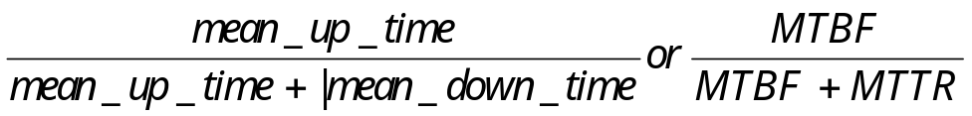
Representative Qualities
  robustness
    A program is robust if it behaves reasonably, even in unspecified circumstances
    Hard to define completely
  availability
    the probability the s/w is working upon request
    10 4 8 2
  safety
    the likelihood that s/w doesn’t cause safety-critical failures
mean time between failure
mean time to repair
up down up down
Availability =? ___18/24___
e.g., ____________
Notes:
Robustness is concerned with acceptable behavior in unusual circumstances. Unlike correctness, robustness is partly a property of a specification; if the specification is not good, the product may be correct but not robust. Safety is an important sub-category of robustness properties, namely, properties that prescribe what the software must not do rather than what it must do.
Note: availability = MTBF/(MTBF+MTTR)
The safety is determined by the likelihood that software doesn’t cause safe-critical failures.
As we stated in the previous slide, a program that is “correct” is, by definition, 100% reliable. Thus the correct programs (or more precisely, the correct [spec, program] pairs) are a subset of the reliable programs (those that exceed some statistical criterion of reliability). However, a correct or reliable program need not be robust or safe. Safety properties are a kind of robustness property, so we draw the safe region within the robust region. Correctness implies safety only when all the needed safety properties have been included in the specification. A program need not be correct or reliable to be safe. In fact, a perfectly useless piece of software can be safe, as long as it doesn’t cause any harm. As we will see, reliability properties are sometimes in conflict with safety and robustness.

Slide 7
Representative Qualities
Performance (cf. Efficiency)
  Efficiency: internal usage of computing resources
  Performance: externally based on user requirement
  relates to cost, reliability, usability, productivity
  initially achieved by analyzing the complexity of algorithms
O(n) O(n²) O(n log n)
Rank? __#1_ _#3__ ___#2____
In Reality? __#2_ _#3__ ___#1__
  a comprehensive approach: performance evaluation
    measurement (data)
    analysis (theoretical model)
    simulation (realistic model)
  performance of s/w process – ____productivity___
Notes:
Any engineering product is expected to perform at a certain level. Unlike other disciplines, in software engineering we often equate performance to efficiency, but they are not the same. Efficiency is an internal quality and refers to how economically the software utilizes the resources of the computer. Performance, on the other hand, is an external quality based on user requirements. For example, a telephone switch may be required to be able to process 10,000 calls per hour. Efficiency affects and often determines the performance of a system.
Analyzing the complexity of algorithms provides only average or worst case information, rather than specific information, about a particular implementation. For more comprehensive treatment, we can use techniques of performance evaluation. The three basic approaches to evaluating the performance of a system are measurement analysis, and simulation. We can measure the actual performance of a system by means of hardware and software monitors that collect data while the system is running and that thereby allow us to discover bottlenecks in the system. In this case, it is crucial to select input data that lead to representative executions of the system. The second approach is to build a model of the product and analyze it. The third approach is to build a model that simulates the product. Analytic models-often based on queuing theory-are usually easier to build, but are less accurate, while simulation models are more costly to build, but are more accurate. We can sometimes combine the two techniques. At the start of a large project, an analytic model can provide a general understanding of the performance-critical areas of the product, pointing out areas where more thorough study is required; then we can build simulation models of these particular areas.
Performance is important because it affects the usability of the system. If a software system is too slow, it reduces the productivity of the users, possibly to the point of not meeting their needs. If a software system uses too much disk space, it may be too expensive to run. If a software system uses too much memory, it may affect the other applications that are run on the same system, or it may run slowly while the operating system tries to balance the memory usage of the different applications.
Performance of software process can be defined as well. For example, productivity.

Slide 8
Representative Qualities
User Friendliness
  if human users find it easy to use
  the key: user interface
  relates to correctness, performance, reliability, safety
  standard user interface would help
Verifiability
  s/w is verifiable if its properties can be verified easily
  by testing or formal analysis methods (c.f. Topic 6)
  software monitors (code inserted) improve verifiability
  an internal and (sometimes) external quality
e.g. __________________
Notes:
A software system is user friendly if its human users find it easy to use. Its subjective depends on many things (experience and type of users), e.g, a novice user may appreciate verbose messages, while an experienced user grows to hate and ignore them. Similarly, a non-programmer may appreciate the use of menus, while a programmer may be more comfortable with typing a command. A software that presents the novice user with a window interface and a mouse is friendlier than one that requires the use of one-letter commands. While an experienced user might prefer a set of commands that minimize the number of keystrokes (that he knew) rather than a fancy window interface (which slows his action because of lengthy navigations). User interface is an important component of user friendliness. A software that produces wrong answers is not friendly, regardless of how fancy its user-interface is. Also, a software which performs more slowly than what the user requires is not friendly, even if the answers are displayed in color. Other related user friendliness issues are: Required average training time; Number of help screens. Standard user interface would help in this regard (e.g., reducing learning curves).
A software system is verifiable if its properties (correctness/performance) can be verified easily. A common technique for improving verifiability is the use of “software monitors” (probes), that is, code inserted in the software to monitor various qualities such as performances or correctness. Modular design, disciplined coding practices, and the use of appropriate programming languages all contribute to verifiability. Verifiability is usually an internal quality, although it sometimes becomes an external quality also (e.g., verifying security of critical applications).

Slide 9
Representative Qualities
Maintainability (____60%____ of total software cost)
  corrective maintenance (____fix____)
    removal of residual s/w errors
    20% of maintenance cost
  adaptive maintenance (___________)
    adjustment of s/w for changes in environment
    20% of maintenance cost
  perfective maintenance (___________)
    improvement of qualities or addition of new features
    60% of maintenance cost
Notes:
The term “software maintenance” is commonly used to refer to the modifications that are made to a software system after its initial release. There is evidence that maintenance costs exceed 60% of the total cost of software.
Maintenance used to be viewed as merely "bug fixing," and it was distressing to discover that so much effort was being spent on fixing defects. Studies have shown, however, that the majority of time spent on maintenance is in fact spent on enhancing the product with features that were not in the original specifications or that were stated incorrectly there.
To analyze maintenance cost it is divided into three categories: corrective, adaptive, and perfective maintenance. Corrective maintenance has to do with the removal of residual errors present in the product when it is delivered as well as errors introduced into the software during its maintenance. Adaptive and perfective maintenance are the real source of change in software; and cause the evolvability as a general principle that should guide the software engineer. Corrective and adaptive maintenance each accounts for nearly 20 percent of maintenance costs while near 60 percent are absorbed by perfective maintenance.

Slide 10
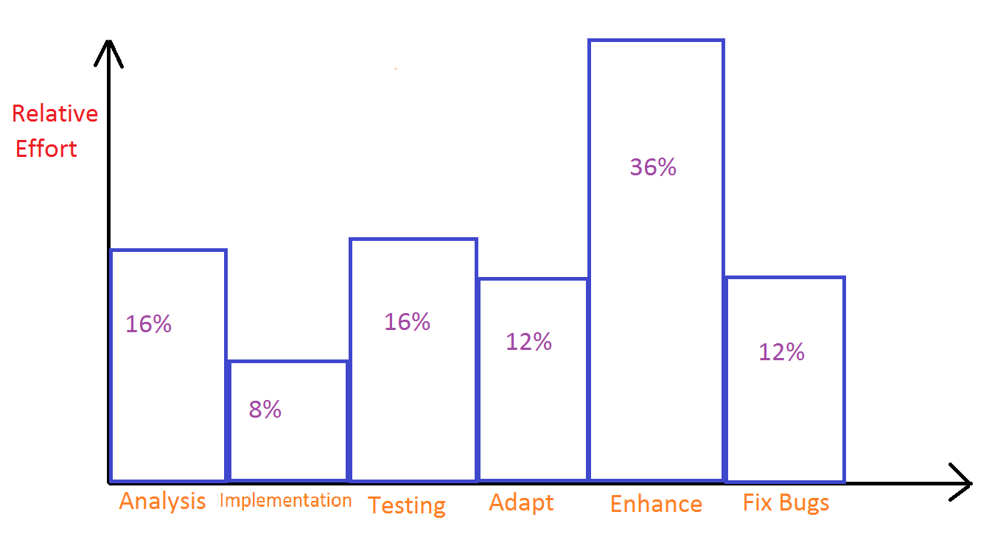
Relative Effort (Cost) Distribution
}
}
Figure 2.1 Distribution of effort in the software life cycle (Boehm, Datamation 1973)
Notes:
Figure 2.1 shows the distribution of the effort (cost) in the software life cycle.

Slide 11
Maintainability
(a) Repairability
  for fixing defects (bugs)
  not “replaceability” for s/w
  s/w needs modularization (module structure + module interfaces) to improve repairability
  achieved through use of proper tools (high-level language, debugger)
(b) Evolvability
  for satisfaction of new requirements (inevitable)
  changes to s/w require discipline
  key: documentation of the s/w evolution
  evolvability is achieved by modularization, but successive changes tend to reduce it
Notes:
"Maintenance" is indeed not the proper word to use with software. First, as it is used today, the term covers a wide range of activities, all having to do with modifying an existing piece of software in order to make an improvement. A term that perhaps captures the essence of this process better is software evolution. Second, in other engineering products, such as computer hardware, automobiles, or washing machines, maintenance refers to the upkeep of the product in response to the gradual deterioration of parts due to extended use of the product. For example, transmissions are oiled and air filters are dusted and periodically changed. To use the word "maintenance" with software gives the wrong connotation, because software does not wear out. Unfortunately, the term is used so widely that we are practically obliged to continue using it here.
A software system is repairable if its defects can be corrected with a reasonable amount of work. In many engineering products, repairability is a major design goal. For example, automobile engines are built with the parts that are most likely to fail as the most accessible. In computer hardware engineering, there is a subspecialty called repairability, availability, and serviceability (RAS).
In other engineering fields, as the cost of a product decreases and the product assumes the status of a commodity, the need for repairability decreases: it is cheaper to replace the whole thing, or at least major parts of it, than to repair it. For example, in early television sets, you could replace a single vacuum tube. Today, a whole board has to be replaced.
A software product that consists of well-designed modules is much easier to analyze and repair than a monolithic one. Merely increasing the number of modules, however, does not make a more repairable product. We need to choose the right module structure with the right module interfaces to reduce the need for module interconnections. The right modularization promotes repairability by allowing errors to be confined to few modules, making it easier to locate and remove them. This is deferred to Topic 5 for discussion.
Repairability of software can be achieved through the usage of proper tools, such as high-level language and debugger.
The fact that software is so malleable makes modifications extremely easy to apply to an implementation. There is a major difference between software modification and the modification of other engineering products. In the case of other engineering products, modifications start at the design level and then proceed to the implementation of the product. For example, if one decides to add a second story to a house, one must first do a feasibility study to check whether the addition can be done safely. Then one is required to do a design, based on the original design of the house. Then the design must be approved, after making sure that it does not violate the existing regulations. Finally, the construction of the new part may be commissioned.
In the case of software, people seldom proceed in such an organized fashion. Although the change might be a radical change in the application, good engineering efforts may be lacking. On the other hand, successful software products are quite long lived. If the software is designed with care, and if each modification is thought out carefully, then it can evolve gracefully.
Most software systems start out being evolvable, but after years of evolution they reach a state where any major modifications runs the risk of “breaking” existing features. In fact, evolvability is achieved by modularization and successive changes tend to reduce the modularity of the original system.
To overcome this problem, the initial design of the product, as well as any succeeding changes, must be done with evolvability in mind. Evolvability is one of the most important software qualities, and we need software engineering principles (in Topic 3) to achieve it. The concept of program families is also for this purpose.
Evolvability is both a product- and process- quality. In terms of the latter, the process mush be able to accommodate new management and organizational techniques, changes in engineering education, etc.

Slide 12
Representative Qualities
Reusability (relates to evolvability)
  s/w reuse reduces cost, enhances reliability, productivity and evolvability
  a typical example: ____libraries____
  reusability should be designed in advance, e.g. o-o design
  object-oriented modules
  design patterns
  e.g., _component based software engineering
  reuse could happen in every phase of s/w engineering
Notes:
Reusability is akin to evolvability. In product evolution, we modify a product to build a new version of that same product; in product reuse, we use the product-perhaps with minor changes-to build another product. Reusability may be applied at different levels of granularity-from whole applications to individual routines-but it appears to be more applicable to software components than to whole products.
A good example of a reusable product is the UNIX shell, which is a command language interpreter; that is, it accepts user commands and executes them. But it is designed to be used both interactively and in "batch." The ability to start a new shell with a file containing a list' of shell commands allows us to write programs scripts in the shell command language. We can view the program as a new product that uses the shell as a component. By encouraging standard interfaces, the UNIX environment in fact supports the reuse of any of its commands, as well as the shell, in building powerful utilities.
Numeric libraries were the first examples of reusable components. Several large FORTRAN libraries, now rewritten in C, C++, and other languages, have existed for many years. Users buy these libraries and use them to build their own products, without having to reinvent or recode well-known algorithms. Several companies are devoted to producing just such libraries. Nowadays, reusable libraries exist for different areas, such as graphical user interfaces, simulation, etc. One of the goals of reusability researchers is to increase the granularity of components that may be reused. One of the goals of object-oriented programming is to achieve both reusability and evolvability.

Slide 13
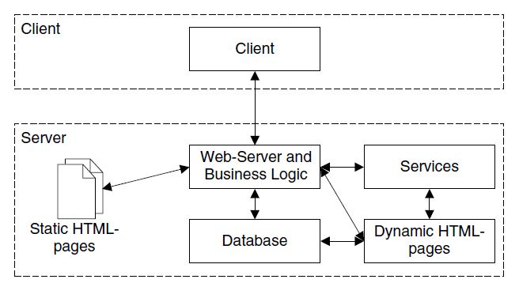
Representative Qualities
Portability
  software is portable if it can run in
  different environments
  portability adds more value to the
  s/w (e.g. UNIX, Windows, Android)
  achieved by “modularity” and separate levels of abstractions (“separation of concerns”)
  a special case of reusability
Understandability
  whether a s/w system is easy to understand
  originally an internal product quality - evolvability, verifiability
  extended to an external product quality - user friendliness
Notes:
Portability is the ease with which software products may be transferred to different hardware and software environments. The term “environment” can refer to a hardware platform or a software environment such as a particular operating system. Java provided a kind of portability but requires virtual machine (to interpret byte-code)
Portability is economically important because it helps amortize the investment in the software system across different environments and different generations of the same environment. Many applications are independent of the actual hardware platform, because the operating system provides portability across hardware platforms. These days, the applications' dependencies are on operating systems and other software systems, such as databases and user interface systems.
Portability may be achieved by modularizing the software so that dependencies on the environment are isolated in only a few modules that must be modified to port the software to another environment. With the proliferation of networked systems, portability has taken on new importance because the execution environment is naturally heterogeneous, consisting of many different kinds of computers and operating systems. In addition, the delivery devices have become diverse. For example, Internet browsers need to be able to run not only on workstations and personal computers, but also on laptops and mobile phones.
Portability among different OS, databases, and user interface systems, can be achieved by modularizing the software so that dependencies on the environment are isolated in only a few modules that must be modified to port the software to another environment. Modularity and separation of concerns are two software engineering principles that we will cover in Topic 3.
Portability is a special case of reusability.
Program modification requires program understanding. Some software systems are easier to understand than others. Of course, some tasks are inherently more complex than others. For example, a system that does weather forecasting, no matter how well it is written, will be harder to understand than one that prints a mailing list. Given tasks of inherently similar difficulty, we can follow certain guidelines to produce more understandable designs and to write more understandable programs.
Understandability is originally an internal product quality for debugging and maintenance purpose, and it is related to developer’s concern on software evolvability and verifiability. It can be extended to an external product quality as user friendliness. Better user friendliness means how to use the software is more understandable to the user.

Slide 14
Representative Qualities
Interoperability
  the ability of system to coexist and cooperate with other systems
  enhanced by setting up standard interface (e.g. UNIX)
  “open system”: an integrated system incorporating independently-written applications (e.g. Web Services)
Productivity
  it measures the efficiency and performance of the s/w process
  defined as size/effort (KLOC / person-year)
  an increasingly important measure
Notes:
Interoperability refers to the ability of a system to coexist and cooperate with other systems-for example, a word-processor’s ability to incorporate a chart produced by a graphing package, or the graphics package’s ability to graph the data produced by a spreadsheet, or the spreadsheet’s ability to process an image scanned by a scanner. While rare in software products, interoperability is plenty in other engineering products. For example, stereo systems from various manufacturers work together and can be connected to television sets and recorders. The UNIX environment, with its standard interfaces, offers a limited example of interoperability within a single environment: UNIX encourages applications to have simple, standard interface, which allows the output of one applications to be used as the input (pipe) to another.
Productivity is a quality of the software production process, referring to its efficiency and performance. An efficient process results in faster delivery of the product. Individual engineers produce software at a certain rate, typically defined as size divided by effort, such as KLOC thousand lines of code per person-year, although there are great variations among individuals of different ability. When individuals are part of a team, the productivity of the team is some function of the productivity of the individuals. Very often, the combined productivity is much less than the sum of the parts. Management tries to organize team members and adopt processes in such manner as to capitalize on the individual productivity of the members.

Slide 15
Representative Qualities
Timeliness
  the ability to deliver a s/w product on time
  lack of timeliness causes “s/w crisis”
    hard to measure and predict schedule
    continuously changing user requirements
    (increasing user needs)
  solution: “incremental delivery” (fast prototyping)
Visibility
  the steps and status of a s/w project are clearly documented
  allow engineers to see the impact of their actions
  both ___internal____ and ______external______
Notes:
Timeliness is a process-related quality that refers to the ability to deliver a product on time. Historically, timeliness has been lacking in software production processes, leading to the “software crisis,” which in turn led to the need for-and birth of- software engineering itself. Today, due to increased competitive market pressures, software projects face even more stringent time-to-market challenges.
The following example illustrates how one company handled its delivery difficulties in the late 1980s: the company had promised the first release of its Ada compiler for a certain date. When the date arrived, the customers who had ordered the product received, instead of the product, a letter stating that, since the product still contained many defects, the manufacturer had decided that it would be better to delay delivery rather than deliver a product containing defects. The product was promised for three months later.
Timeliness by itself may not be a useful quality, although being late may sometimes close market opportunities. Delivering on time a product that is lacking in other qualities, such as reliability or performance, is pointless. Timeliness requires careful scheduling, accurate work estimation, and clearly specified and verifiable milestones. It also requires standard project management techniques to achieve timeliness.
Even now, many current processes fail to result in a timely product, and software crisis continues. This is because it is hard to measure and predict schedule accurately in the beginning, Moreover, there are often continuously changing user requirements, particularly increasing user needs. A strict waterfall model cannot be followed.
One solution to timeliness issue is “incremental delivery”, such as the technique of fast prototyping. We will address “Incrementality” as a software engineering principle in the next topic.
A software development process is visible if all of its steps and its current status are documented clearly. In many software projects, most engineers and even managers are unaware of the exact status of the project.

Slide 16
Topic 2 Conclusion
Software nature makes it distinguished from hardware dramatically
Software quality is hard to define and measure comprehensively
Software qualify can be classified as external vs. internal qualities, and product vs. process qualities
We need to understand representative software qualities

